Slide 1
Dexterous Hand Manipulation with Learning from Demonstrations
Kejia Ren (kren6@jhu.edu)
Shimin Pan (span20@jhu.edu)

Slide 2
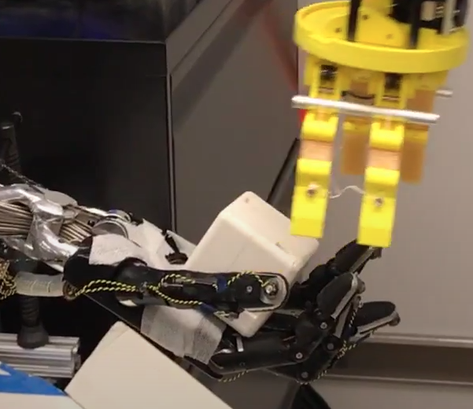
Background
Why important?
In human-centric environments, dexterous multi-fingered hands are essential to perform a variety of complex tasks, such as grasping, tool use, etc.
Why challenging?
High-dimensionality of human-like five-finger hand
The system is highly coupled.
Contact-rich scenarios
Hard to solve with model-based methods,
thus researchers tend to use model-free RL.

Slide 3
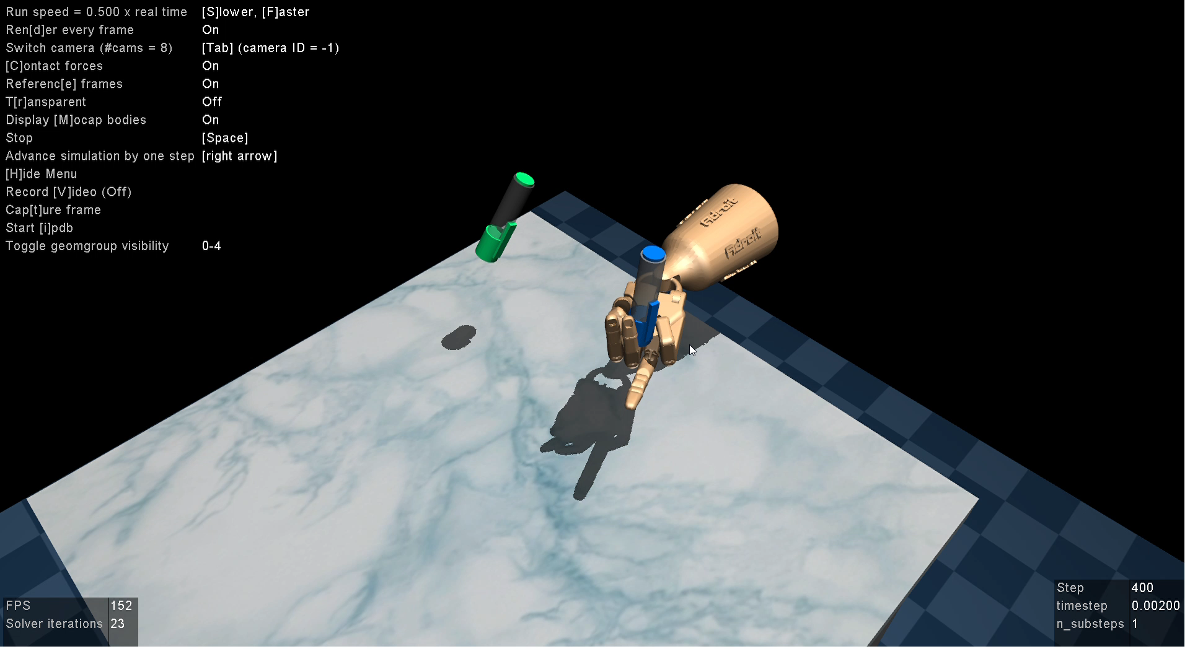
Environment
Customized Gym environment simulated with MuJoCo physics engine:
https://github.com/vikashplus/mj_envs

Slide 4
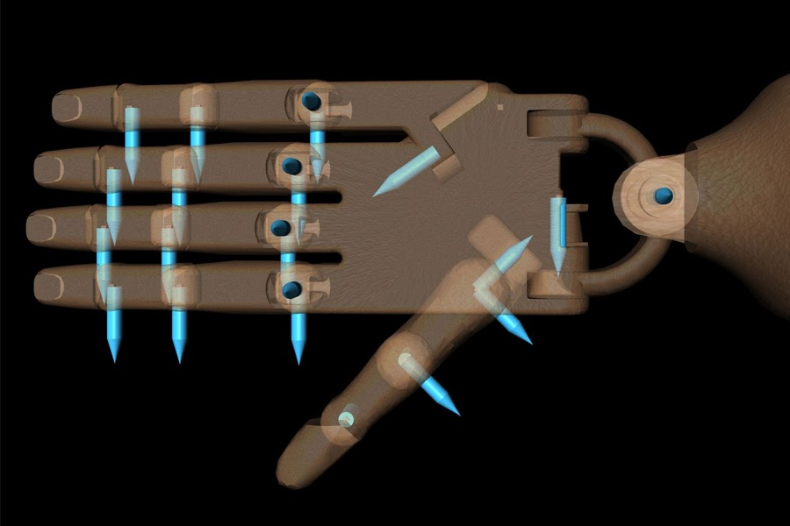
RL Formulation
Goal:
Control 24-DoF (24 joints) robot hand to manipulate the pen to its target pose.
Episodic:
Episode terminates either when it exceeds the preset maximum steps, or when a failure occurs.
Failure: the pen drops off
State (continuous, 45-dim vector):
Hand Joint Angles (24 DoF ), Pen’s Position/Orientation (6 DoF), Pen’s Velocity (6 DoF), Pen’s Target Orientation (3 DoF), Pen’s Position-Target Position (3 DoF), Pen’s Orientation-Target Orientation (3 DoF)
Action (continuous, 24-dim vector):
Desired Hand Joint Angles at next timestep (24 DoF)

Slide 5
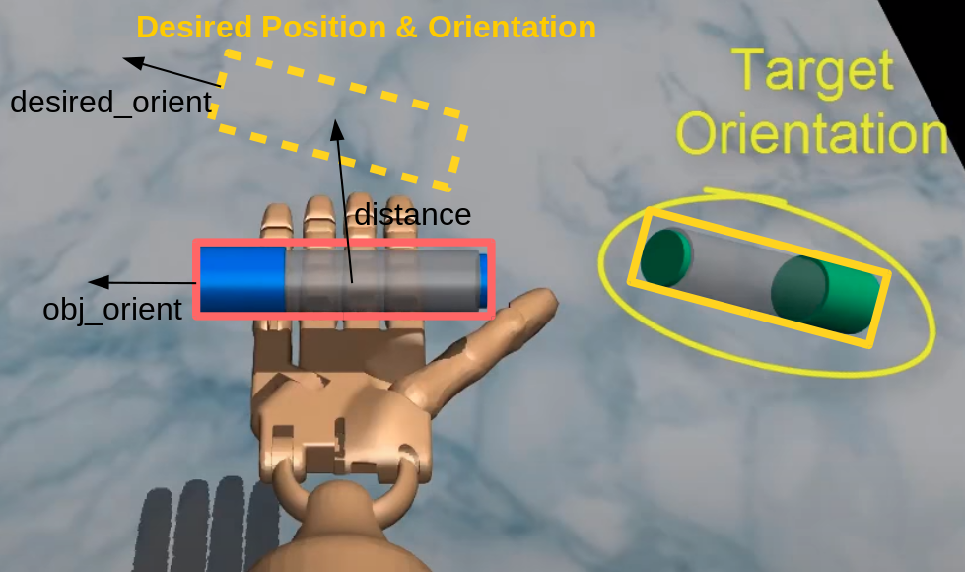
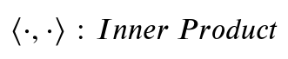
RL Formulation
Reward (scalar)
Heavily shaped

Slide 6
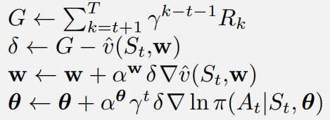
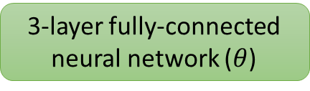
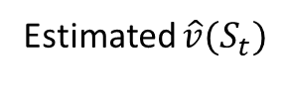
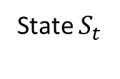
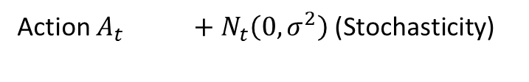
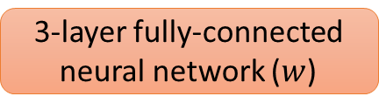
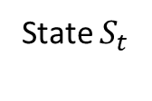
DAPG (Demo Augmented Policy Gradient)
“Batch” REINFORCE with Baseline
For each step of the episode:
$\hat{v}(S_{t}, w)$: Value-function (Baseline) Network
State $S_{t}$
3-layer fully-connected neural network ($w$)
Estimated $\hat{v}(S_{t})$
$π\left(A_{t}\right|S_{t}, θ):$ Policy Network
3-layer fully-connected neural network ($θ$)
State $S_{t}$
Action $A_{t}$ $+ N_{t}\left(0, σ^{2}\right)$ (Stochasticity)
Reference: Rajeswaran, Aravind, et al. "Learning complex dexterous manipulation with deep reinforcement learning and demonstrations." arXiv preprint arXiv:1709.10087 (2017).

Slide 7
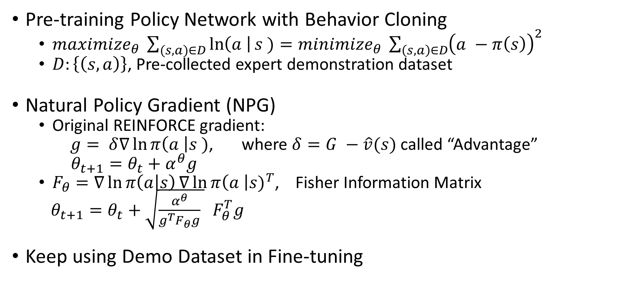
DAPG (Demo Augmented Policy Gradient)
Pre-training Policy Network with Behavior Cloning
$maximi{ze}_{θ} \sum_{(s, a)∈D}{\ln\left(a \right|s )}=minimize_{θ} \sum_{\left(s, a\right)∈D}{{\left(a −π\left(s\right)\right)}^{2}}$
$D:\left\{\left(s, a\right)\right\}$, Pre-collected expert demonstration dataset
Natural Policy Gradient (NPG)
Original REINFORCE gradient:
$g= δ∇\ln{π\left(a \right|s )}$, where $δ=G −\hat{v}(s)$ called “Advantage”
$θ_{t+1}=θ_{t}+α^{θ}g$
$F_{θ}=∇\ln{π\left(a | s\right)}∇{\ln{π\left(a \right|s)}}^{T}$, Fisher Information Matrix
$θ_{t+1}=θ_{t}+\sqrt{\frac{α^{θ}}{g^{T}F_{θ}g} } F_{θ}^{T}g$
Keep using Demo Dataset in Fine-tuning

Slide 8
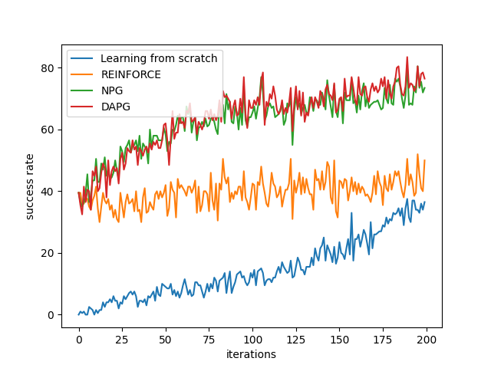
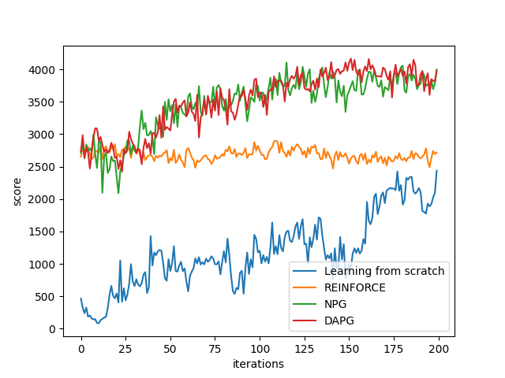
Experimental Verifications
Evaluations (over 200 iterations of training):
Success Rate
Success: difference between current and target pen pose within a small threshold
Score (Averaged total reward)

Slide 9
Our Extensions
Possible problems DAPG may suffer:
1. On-policy exploration (inefficient)
2. Monte-Carlo method (high variance)
3. Policy too simple (only depends on current state)

Slide 10
Our Extensions
Possible problems DAPG may suffer:
1. On-policy exploration (inefficient)
→ Off-policy sampling
2. Monte-Carlo method (high variance)
→ Bootstrapping / TD (Temporal Differential)
3. Policy too simple (only depends on current state)
→ Recurrent policy

Slide 11
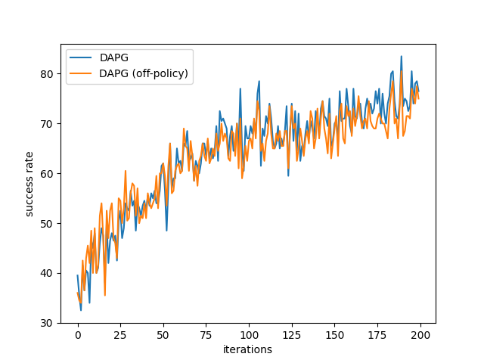
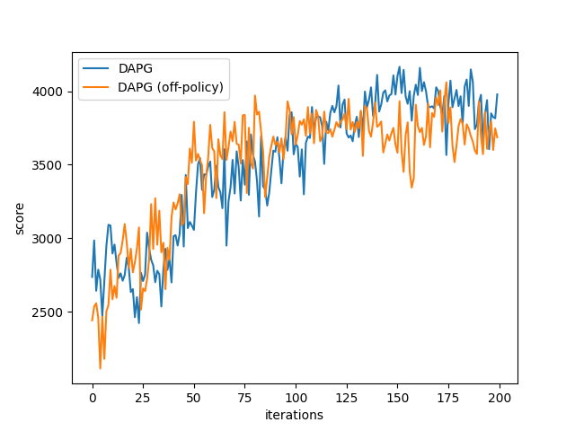
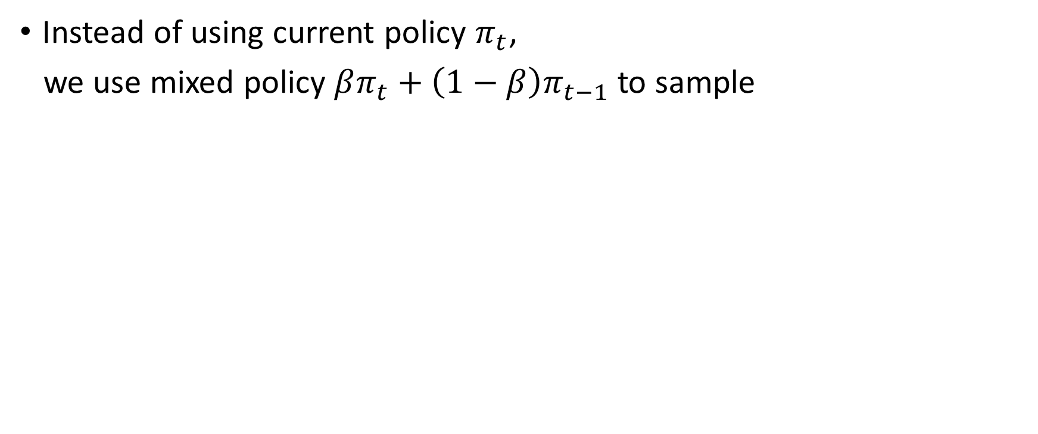
1. Off-policy Sampling
Instead of using current policy $π_{t}$,
we use mixed policy $βπ_{t}+\left(1−β\right)π_{t−1}$to sample

Slide 12
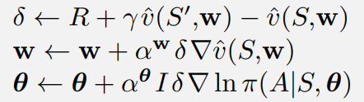
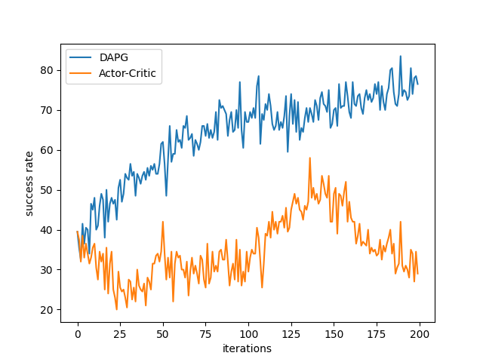
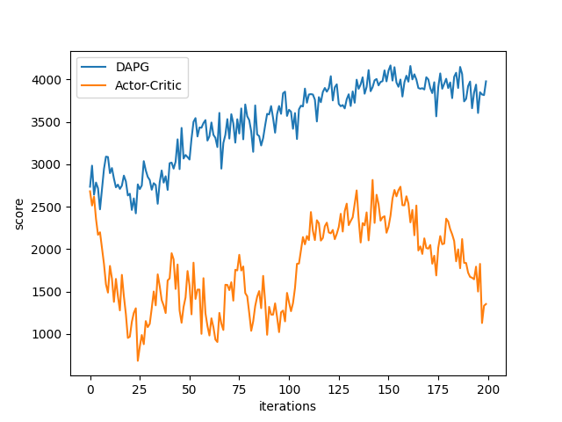
2. Bootstrapping
Actor-Critic (biased, but good variance):
REINFORCE
Actor-Critic
Failed ☹
Perhaps too biased?

Slide 13
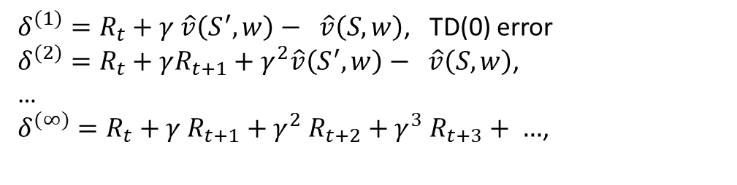
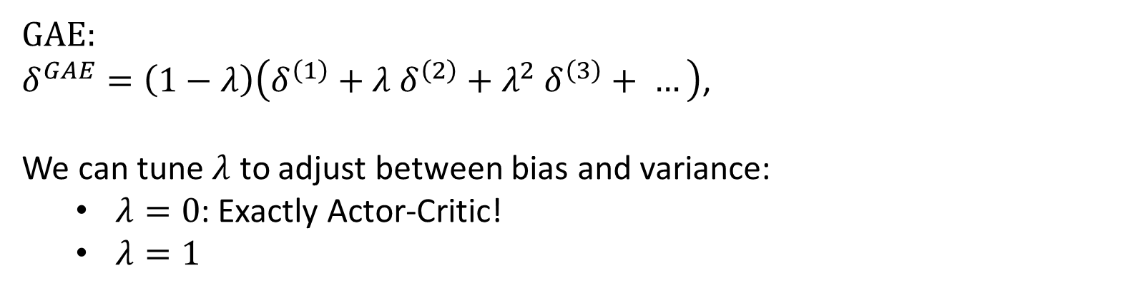
2. Bootstrapping (GAE)
Generalized Advantage Estimation (GAE)
Actor-Critic
$δ^{(1)}=R_{t}+γ \hat{v}\left(S^{′}, w\right)− \hat{v}\left(S, w\right)$, TD(0) error
$δ^{(2)}=R_{t}+γR_{t+1}+γ^{2}\hat{v}\left(S^{′}, w\right)− \hat{v}\left(S, w\right)$,
…
$δ^{(∞)}=R_{t}+γ R_{t+1}+γ^{2} R_{t+2}+γ^{3} R_{t+3}+ …$,
GAE:
$δ^{GAE}=\left(1−λ\right)\left(δ^{\left(1\right)}+λ δ^{\left(2\right)}+λ^{2} δ^{\left(3\right)}+ …\right)$,
We can tune $λ$ to adjust between bias and variance:
$λ=0$: Exactly Actor-Critic!
$λ=1$
Bias decreases
Variance increases
Reference: Schulman, John, et al. "High-dimensional continuous control using generalized advantage estimation." arXiv preprint arXiv:1506.02438 (2015).

Slide 14
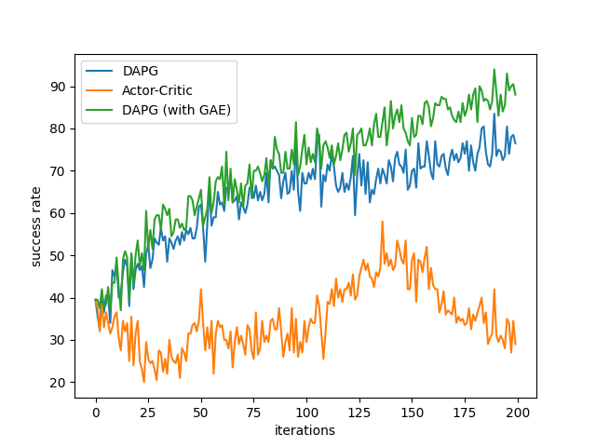
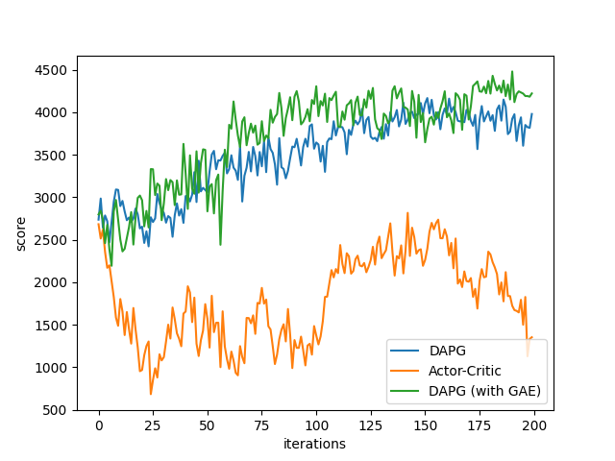
2. Bootstrapping (GAE)
GAE works! ☺

Slide 15
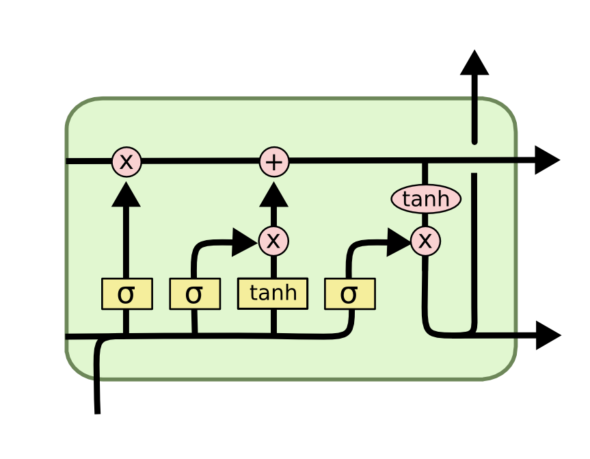
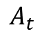
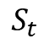
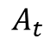
3. Recurrent Policy
We use LSTM unit to replace the middle layer for policy network
$$A_{t}$$
$$A_{t}$$
FC2
FC2
LSTM unit
tanh
ReLU
FC2
becomes
LSTM
tanh
ReLU
FC1
FC1
$$S_{t}$$
$$S_{t}$$

Slide 16
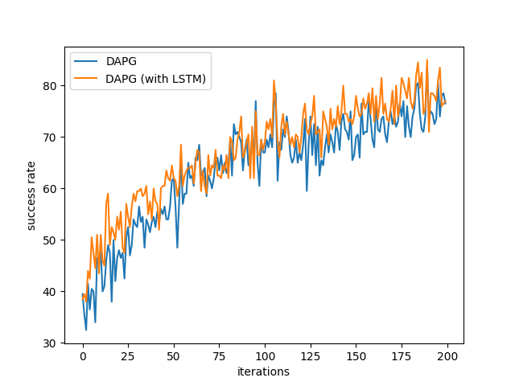
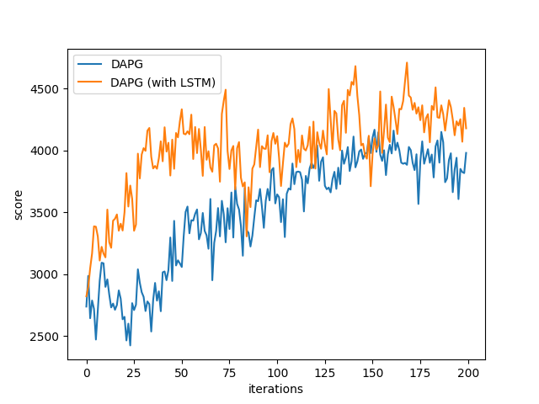
3. Recurrent Policy
LSTM also helps! ☺

Slide 17
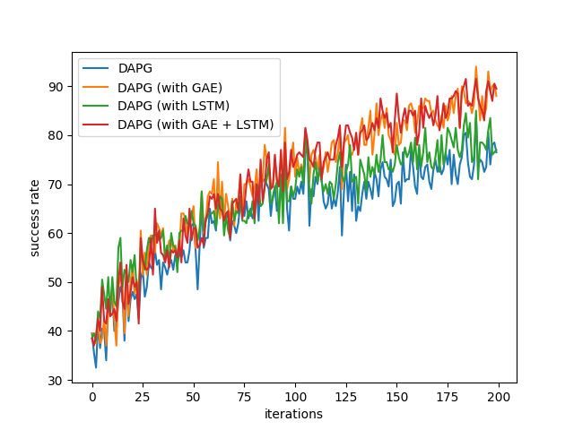
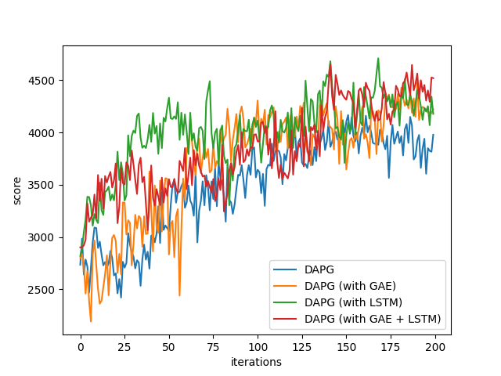
Summary
GAE and LSTM policy both helps accelerate the learning,
which beats the original DAPG.

Slide 18
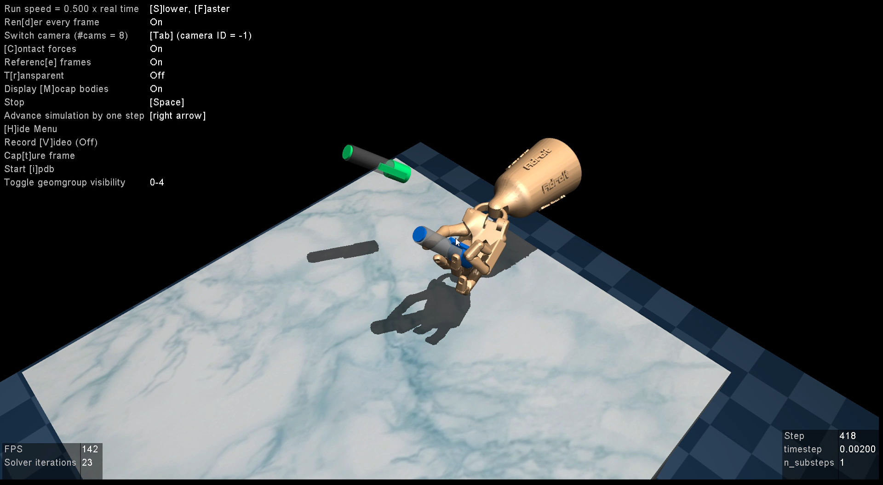
Visualization of Results
After Behavior Cloning

Slide 19

Visualization of the Policy
DAPG

Slide 20
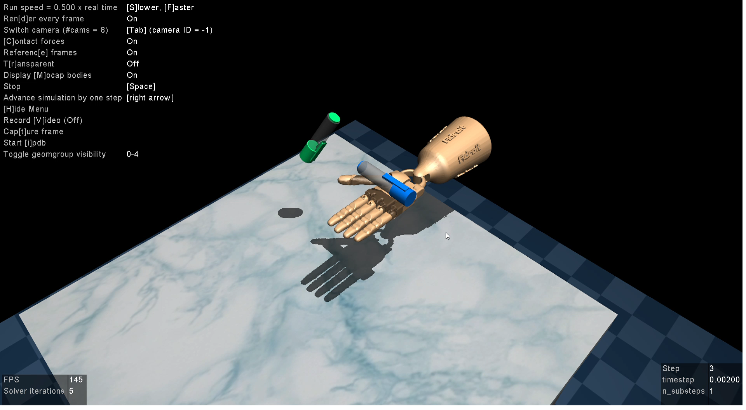
Visualization of the Policy
DAPG (with GAE + LSTM)

